Slide 1
GO Team Business Meeting #2
Where we are – Where we’re going
Dr. Patricia Ford
South Atlanta High School
Thursday, December 11, 2024

Slide 2
Where We Are
Our strategic plan is the guide for the work we’re doing in the school. By monitoring the plan and ranking priorities, we can all work towards the common goals. Using the priorities in the strategic plan, the school leadership team developed a Continuous Improvement Plan (CIP) for the current school year.

Slide 3
Timeline for GO Teams
You are HERE
Fall 2021
GO Team Developed 2021-2025 Strategic Plan
1
Summer 2024
School Leadership completed Needs Assessment and defined overarching needs for SY24-25
2
August 2024
School Leadership completed 2024-2025 Continuous Improvement Plan
3
Sept. – Dec. 2024
Utilizing current data, the GO Team will review & possibly update the school strategic priorities and plan
4
Before Winter Break
GO Team will take action (vote) on the rank of the strategic plan priorities for SY25-26 in preparation for budget discussions.
5

Slide 4
Discussion Items
Georgia Milestones Math Data
Graduation Rate Data
Continuous Improvement Plan Presentation
Continuous Improvement Plan and Strategic Plan Alignment
45-Day Continuous Improvement Plan Check-in
Fall to Winter MAP Data
Strategic Plan and Continuous Improvement Plan Progress
Ranking Strategic Plan Priorities

Slide 5
Current Strategic Plan
2021-2025

Slide 6
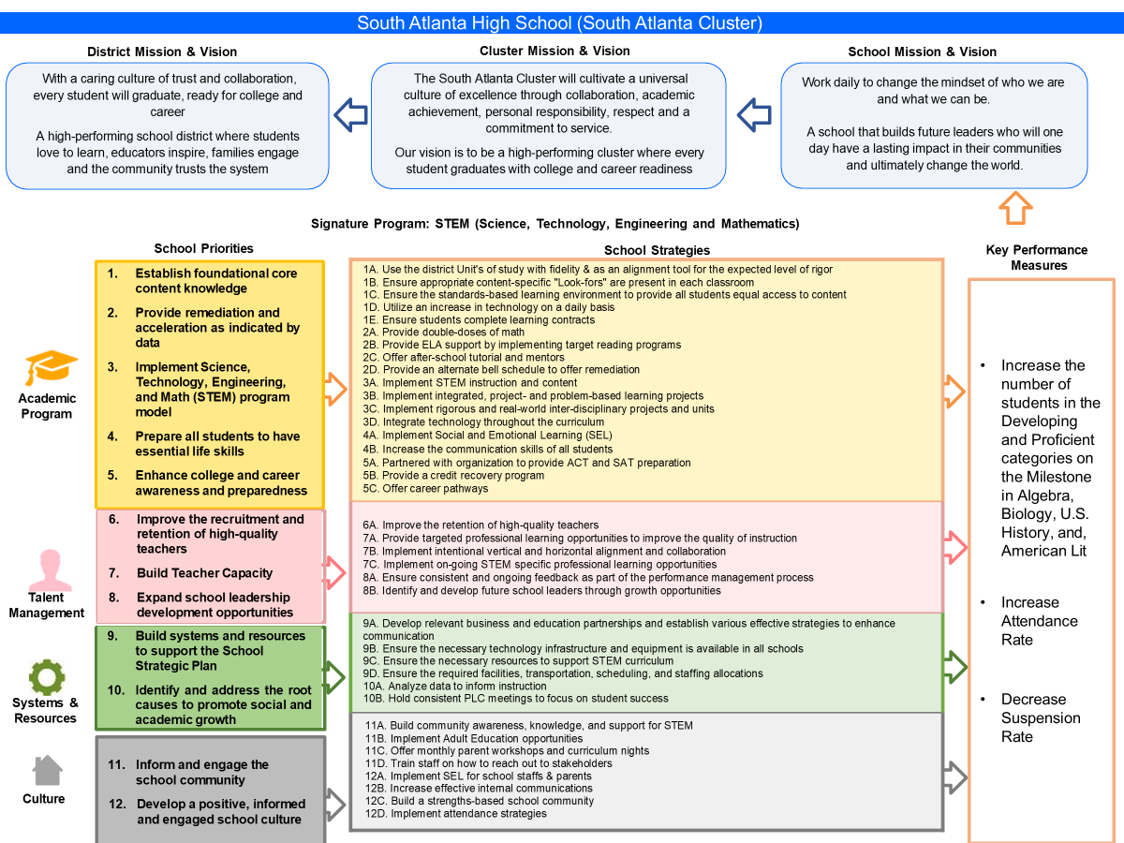

Slide 7
Data

Slide 8
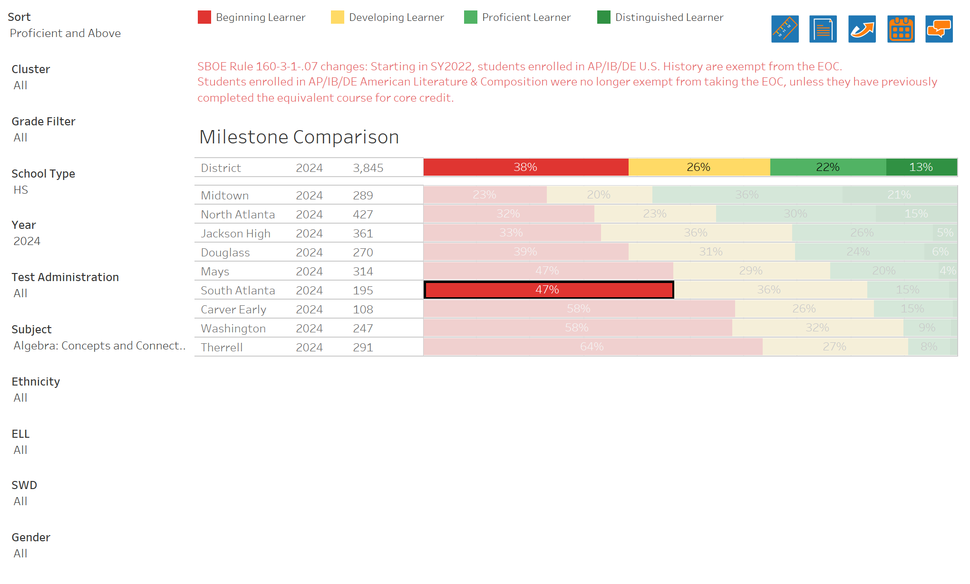
GA Milestones Math Results

Slide 9
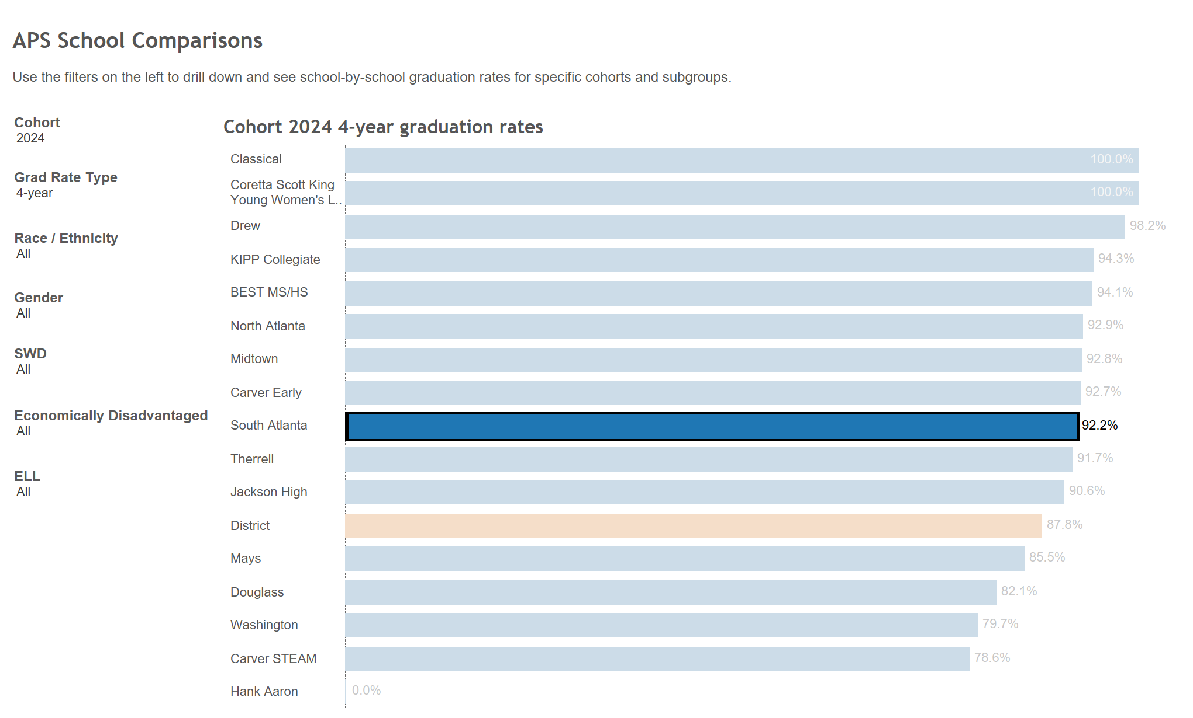
Graduation Rate

Slide 10
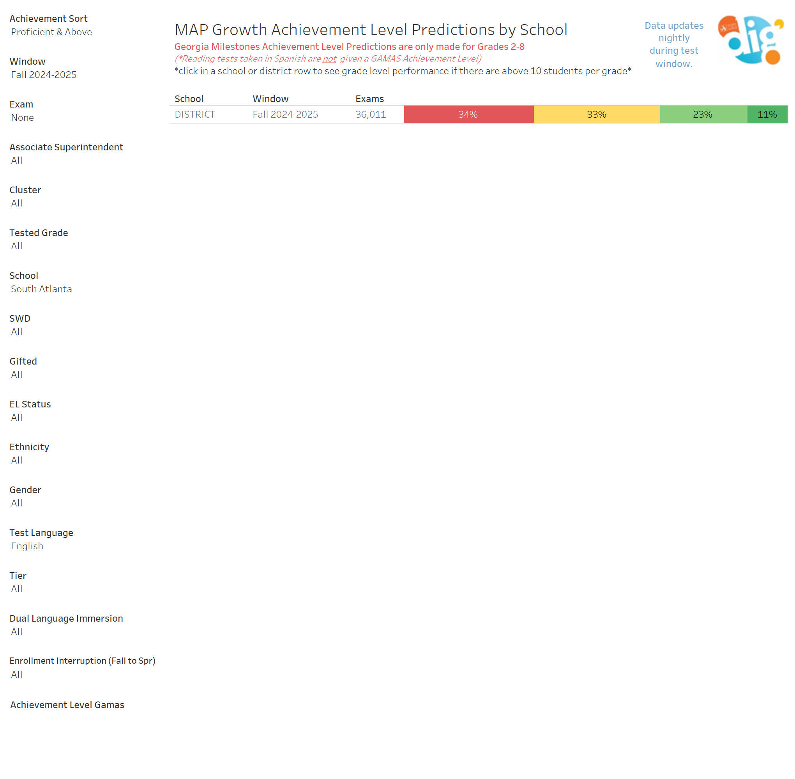
Fall MAP Results

Slide 11
GO Team Discussion: Data Protocol
What do you notice?
What are your wonderings?
Based on our school’s trend data from MAP assessments and end-of-year test assessments, which student sub-groups and grade levels showed the most significant gaps or unexpected trends?
Based on our school’s trend data from MAP assessments, Milestones and other indicators, are there specific trends that require more focused attention?
What additional questions do you have?

Slide 12
Continuous Improvement Plan

Slide 13
szzaweeeeeeeeee
*UTILIZE DATA ANALYSIS PROTOCOL SYNTHESIS RESPONSES*
Strengths | Challenges
Students demonstrated growth on the Map Assessment from Winter to Spring in 43% ELA and 38% Math | Students’ underperformance in American Literature, US History, and Biology EOC assessments. EOC scores for American Literature decreased from 14% (22-23Y) to 7% (23-24SY). EOC scores for US History decreased from 17% (22-23Y) to 17% (23-24SY). EOC scores for Biology decreased from 11% (22-23Y) to 6% (23-24SY).
Student suspension rate decreased from 2.35 (22-23SY) to 1.30 (23-24SY) | 39 percent of students not on track to graduate impacting the overall graduation rate.
Increased CCRPI attendance from 31.2% to 37.7% | High absenteeism by students.
Notes:
Notes for School CIP Teams: After completing your Comprehensive Needs Assessment ( data protocol), you will come here and identify some strengths and opportunities/challenges you have observed from the data. The priority areas are Literacy, Numeracy, and Whole Child & Student Support. Identify an overarching need for each area. Formulate a problem statement for each area. Make sure the problem statement meets the criteria. Refer to your CIP resources.

Slide 14
Our Overarching Needs
Whole Child & Intervention | CCRPI Content Mastery | CCRPI Graudation Rate | College & Career Readiness
Whole Child & Intervention Problem Statement | CCRPI Content Mastery Prolem Statement | CCRPI Graudation Rate Problem Statement | College & Career Readiness Problem Statement
Student chronic absenteeism is still a challenge resulting in 37.7% CCRPI attendance rate for the 23-24SY. A systematic practice in tracking student attendance was not executed with fidelity across all grade bands . | The percentage of students in grades 9-12 with a projected Georgia Milestones achievement level of proficient or above in ELA/Reading on the district universal screening assessment decreased from 13% in May 2023 to 12% in May 2024. | The percentage of students in Cohort 2025 on track to graduate in 4 years is 61%. | Students are not being identified in the 9th grade regarding their potential pathways to achieve college and career readiness.
Why? | Why? | Why? | Why?
Wraparound services are impacting overall CCRPI attendance due to inconsistent practices of monitoring and supporting students with low CCRPI attendance. | Student chronic absenteeism in American Literature , an assessed course of the Georgia Milestones. | Many students are failing to earn the necessary credits each year. | There is no formal process or program in place to assess and guide students in the 9th grade towards college and career readiness.
Why? | Why? | Why? | Why?
The step by step process used for attendance monitoring was not clearly communicated, implemented and monitored to stakeholders who serve in roles that support attendance. | Teacher inconsistently demonstrates understanding of curriculum, subject content, pedagogical knowledge, and student needs, or lacks fluidity in using the knowledge in practice | A significant number of students are not passing their required courses. | The school lacks a structured framework and resources dedicated to early identification and career planning.
Why? | Why? | Why? | Why?
Inconsistentcies with the internalization of the CCRPI attendance monitoring tool to effectively implement and monitor student attendance in each grade level. | Teacher preparation and certification correlate with student achievement. | Students are struggling with the coursework and exams. | There is insufficient focus and investment in career and college readiness programs at the early high school level.
Why? | Why? | Why? | Why?
 | Teacher inconsistently uses state and local school district curricula and standards, or inconsistently uses effective strategies, resources, or data in planning to meet the needs of all students | There is a lack of adequate academic support and intervention for students who are falling behind. | The school may prioritize immediate academic concerns and standardized testing over long-term career and college readiness planning.
Why? | Why? | Why? | Why?
 | The teacher inconsistently uses research-based instructional strategies

Slide 15
Identification of Goals and Strategies
Each school participating in the Fund 150 consolidation program must complete an Intent and Purpose form. This form must provide an accurate description of how the intent and purpose for each program will be met. Instructions: Using the chart below, describe how the Intent and Purpose for each consolidated funding source will be met by the school.
Intent and Purpose Action Steps
Whole Child & Intervention SMART Goal
Increase CCRPI attendance from 37.7% to 44.7% by incentivizing students to attend school daily.
Action Steps | Person/Position Responsible | Timeline of Implementation | Method for Monitoring Implementation | Method for Monitoring Effectiveness | APS 5 | Programs Consolidated in School
Implement team to provide wrap around support to every student. Specific support will be given to students identified as bubble students and highflyers. | Grade level teams | August - May 2025 | 100% of students identified as bubble students and highflyers will receive monthly incentives. | The identified bubble students and highflyers CCRPI attendance will increase by 5% from August to December. | N/A | Title I, A | TRUE
 |  |  |  |  |  | Parent & Family Enagagement | FALSE
 |  |  |  |  |  | SIG, A | FALSE
 |  |  |  |  |  | Title IV, B | FALSE
 |  |  |  |  |  | Title IV, A
 |  |  |  |  |  | Safe & Healthy | FALSE
 |  |  |  |  |  | Well - Rounded | TRUE
 |  |  |  |  |  | Effective Use of Technology | FALSE
Provide Parent Workshops aimed at supporting the whole child at home. | Family Engagement Leadership Team, Restorative Practices Coach, School Social Worker | August - May 2025 | 100% of parents/guardians will be sent notification of the scheduled parent workshops | 25% of parents/guardians of enrolled scholars will attend monthly meetings | N/A | Title I, A | FALSE
 |  |  |  |  |  | Parent & Family Enagagement | TRUE
 |  |  |  |  |  | SIG, A | FALSE
 |  |  |  |  |  | Title IV, B | FALSE
 |  |  |  |  |  | Title IV, A
 |  |  |  |  |  | Safe & Healthy | FALSE
 |  |  |  |  |  | Well - Rounded | FALSE
 |  |  |  |  |  | Effective Use of Technology | FALSE
Bi-weekly monitoring of student attendance and behavior, as evidenced in Infinite Campus, teacher updates and APS Graphs | Grade level clerk, Restorative Practices Coach, Assistant Principal, Social Worker, School Residency Officer | August - May 2025 | 100% of students identified as bubble students and highflyers for attendance and behavior will be added to weekly tracking forms and rewarded with incentives upon successful completion. | 80% of students identified will have increased student attendance and decreased behavior challenges from Aug. 2024-May 2025 | N/A | Title I, A | TRUE
 |  |  |  |  |  | Parent & Family Enagagement | FALSE
 |  |  |  |  |  | SIG, A | FALSE
 |  |  |  |  |  | Title IV, B | FALSE
 |  |  |  |  |  | Title IV, A
 |  |  |  |  |  | Safe & Healthy | FALSE
 |  |  |  |  |  | Well - Rounded | TRUE
 |  |  |  |  |  | Effective Use of Technology | FALSE
Subgroup Action Steps for Whole Child & Intervention (required)
Action Steps | Person/Position Responsible | Timeline of Implementation | Method for Monitoring Implementation | Method for Monitoring Effectiveness | APS 5 | Programs Consolidated in School
Implement team to provide wrap around support to every student. Specific support will be given to SWD and ELL students identified as bubble students and highflyers for attendance and behavior. | Grade level teams | August - May 2025 | 100% of students identified as bubble students and highflyers will receive monthly incentives. | The identified buble students and highflyers CCRPI attendance will increase by 5% from August to December. | N/A | Title I, A | TRUE
 |  |  |  |  |  | Parent & Family Enagagement | FALSE
 |  |  |  |  |  | SIG, A | FALSE
 |  |  |  |  |  | Title IV, B | FALSE
 |  |  |  |  |  | Title IV, A
 |  |  |  |  |  | Safe & Healthy | FALSE
 |  |  |  |  |  | Well - Rounded | TRUE
 |  |  |  |  |  | Effective Use of Technology | FALSE
Provide a mentor for each highflyer through their assigned case manager | SELTs and case manager | Aug.-May 2025 | 100% of identified students will meet with mentors weekly via advisory | 90% of students will complete surveys identifying mentor and support provided | N/A | Title I, A | TRUE
 |  |  |  |  |  | Parent & Family Enagagement | FALSE
 |  |  |  |  |  | SIG, A | FALSE
 |  |  |  |  |  | Title IV, B | FALSE
 |  |  |  |  |  | Title IV, A
 |  |  |  |  |  | Safe & Healthy | FALSE
 |  |  |  |  |  | Well - Rounded | TRUE
 |  |  |  |  |  | Effective Use of Technology | FALSE

Slide 16
Identification of Goals and Strategies
Each school participating in the Fund 150 consolidation program must complete an Intent and Purpose form. This form must provide an accurate description of how the intent and purpose for each program will be met. Instructions: Using the chart below, describe how the Intent and Purpose for each consolidated funding source will be met by the school.
Intent and Purpose Action Steps
Whole Child & Intervention SMART Goal
Increase CCRPI attendance from 37.7% to 44.7% by incentivizing students to attend school daily.
Action Steps | Person/Position Responsible | Timeline of Implementation | Method for Monitoring Implementation | Method for Monitoring Effectiveness | APS 5 | Programs Consolidated in School
Implement team to provide wrap around support to every student. Specific support will be given to students identified as bubble students and highflyers. | Grade level teams | August - May 2 | 100% of students identified as bubble students and highflyers will receive monthly incentives. | The identified bubble students and highflyers CCRPI attendance will increase by 5% from August to December. | N/A | Title I, A | TRUE
 |  |  |  |  |  | Parent & Family Enagagement | FALSE
 |  |  |  |  |  | SIG, A | FALSE
 |  |  |  |  |  | Title IV, B | FALSE
 |  |  |  |  |  | Title IV, A
 |  |  |  |  |  | Safe & Healthy | FALSE
 |  |  |  |  |  | Well - Rounded | TRUE
 |  |  |  |  |  | Effective Use of Technology | FALSE
Provide Parent Workshops aimed at supporting the whole child at home. | Family Engagement Leadership Team, Restorative Practices Coach, School Social Worker | August - May 2025 | 100% of parents/guardians will be sent notification of the scheduled parent workshops | 25% of parents/guardians of enrolled scholars will attend monthly meetings | N/A | Title I, A | FALSE
 |  |  |  |  |  | Parent & Family Enagagement | TRUE
 |  |  |  |  |  | SIG, A | FALSE
 |  |  |  |  |  | Title IV, B | FALSE
 |  |  |  |  |  | Title IV, A
 |  |  |  |  |  | Safe & Healthy | FALSE
 |  |  |  |  |  | Well - Rounded | FALSE
 |  |  |  |  |  | Effective Use of Technology | FALSE
Bi-weekly monitoring of student attendance and behavior, as evidenced in Infinite Campus, teacher updates and APS Graphs | Grade level clerk, Restorative Practices Coach, Assistant Principal, Social Worker, School Residency Officer | August - May 2025 | 100% of students identified as bubble students and highflyers for attendance and behavior will be added to weekly tracking forms and rewarded with incentives upon successful completion. | 80% of students identified will have increased student attendance and decreased behavior challenges from Aug. 2024-May 2025 | N/A | Title I, A | TRUE
 |  |  |  |  |  | Parent & Family Enagagement | FALSE
 |  |  |  |  |  | SIG, A | FALSE
 |  |  |  |  |  | Title IV, B | FALSE
 |  |  |  |  |  | Title IV, A
 |  |  |  |  |  | Safe & Healthy | FALSE
 |  |  |  |  |  | Well - Rounded | TRUE
 |  |  |  |  |  | Effective Use of Technology | FALSE
Subgroup Action Steps for Whole Child & Intervention (required)
Action Steps | Person/Position Responsible | Timeline of Implementation | Method for Monitoring Implementation | Method for Monitoring Effectiveness | APS 5 | Programs Consolidated in School
Implement team to provide wrap around support to every student. Specific support will be given to SWD and ELL students identified as bubble students and highflyers for attendance and behavior. | Grade level teams | August - May 2025 | 100% of students identified as bubble students and highflyers will receive monthly incentives. | The identified buble students and highflyers CCRPI attendance will increase by 5% from August to December. | N/A | Title I, A | TRUE
 |  |  |  |  |  | Parent & Family Enagagement | FALSE
 |  |  |  |  |  | SIG, A | FALSE
 |  |  |  |  |  | Title IV, B | FALSE
 |  |  |  |  |  | Title IV, A
 |  |  |  |  |  | Safe & Healthy | FALSE
 |  |  |  |  |  | Well - Rounded | TRUE
 |  |  |  |  |  | Effective Use of Technology | FALSE
Provide a mentor for each highflyer through their assigned case manager | SELTs and case manager | Aug.-May 2025 | 100% of identified students will meet with mentors weekly via advisory | 90% of students will complete surveys identifying mentor and support provided | N/A | Title I, A | TRUE
 |  |  |  |  |  | Parent & Family Enagagement | FALSE
 |  |  |  |  |  | SIG, A | FALSE
 |  |  |  |  |  | Title IV, B | FALSE
 |  |  |  |  |  | Title IV, A
 |  |  |  |  |  | Safe & Healthy | FALSE
 |  |  |  |  |  | Well - Rounded | TRUE
 |  |  |  |  |  | Effective Use of Technology | FALSE

Slide 17
Quarterly CIP Check-in
As part of the Continuous Improvement process, all APS schools are completing a quarterly check-in for the Continuous Improvement Plans.
Questions to Consider
Based on our year long CIP plan, what are the actions that the school has already completed?​
What data supports the completion of an action step and success criteria (both implementation and student achievement)?

Slide 18
Before Presenting to your GO Team:
Insert Your School’s CIP Quarterly Check-In
(use appropriate form and as many slides as necessary)

Slide 19
GO Team Activity & Discussion
GO TEAM DISCUSSION: Review the priorities and goals in your strategic plan and the information and goals CIP. Reflect on if updates need to be made to the Strategic Plan.
Are all CIP Goals reflected in
our Strategic Plan Priorities?
If not, which CIP Goal(s) are missing and should be added to the Strategic Plan?

Slide 20
Activity & Discussion
GO TEAM DISCUSSION: Review the priorities and goals in your strategic plan and reflect on if the expected progress is being made. These guiding questions will help you determine what, if any, updates are needed for your school’s strategic plan.
What progress has been made towards the priorities identified in our Strategic Plan? What evidence/data do we have?
Based upon available data, are there any other adjustments we need to make to the Strategic Plan?

Slide 21
Updates to the
Strategic Plan
Enter all changes/updates to your plan – be sure to include accountability measures, as appropriate.

Slide 22
Action on the Updated Strategic Plan
The GO Team needs to TAKE ACTION (vote) on its updated Strategic Plan. After the motion and a second, the GO Team may have additional discussion. Once discussion is concluded, the GO Team will vote.

Slide 23
Preparing for Budget Development

Slide 24
Discussion
Strategic Plan Priority Ranking
In preparation for the 2025-2026 Budget Development (January–March 2025), the GO Team needs to rank its Strategic Plan Priorities. Use the next slide to capture the priority ranking.

Slide 25
Strategic Plan
Priority Ranking
Insert the school’s priorities from Higher to Lower
Higher
Lower

Slide 26
Action on the Strategic Plan Priorities
The GO Team needs to TAKE ACTION (vote) on its ranked Strategic Plan Priorities. After the motion and a second, the GO Team may have additional discussion. Once discussion is concluded, the GO Team will vote.

Slide 27
Where we’re going
At our next meeting we will begin the discussion of the 2025-2026 budget.
Let me or the Chair know of any additional information you need for our future discussion.

Slide 28
Strategic planning will help you fully uncover your available options, set priorities for them, and define the methods to achieve them.
Robert J. Mckain

Slide 29
Where we’re going
At our next meeting(s) we will discuss how our data is aligning to our strategic plan and determine if we need to make any adjustments.
Before the end of Fall Semester, we will take Action (vote) on any updates to our strategic plan and the ranking our strategic priorities for the 2024-2025 school year.
Let me or the Chair know of any additional information you need for our future discussion.

Slide 30
Principal’s Report

Slide 31
Security Grant Update
$45,000 security grant will be used by purchasing door alarm monitoring panels.

Slide 32
Thank you

